Slide 1
Agriculture Project
Will Callan

Slide 2
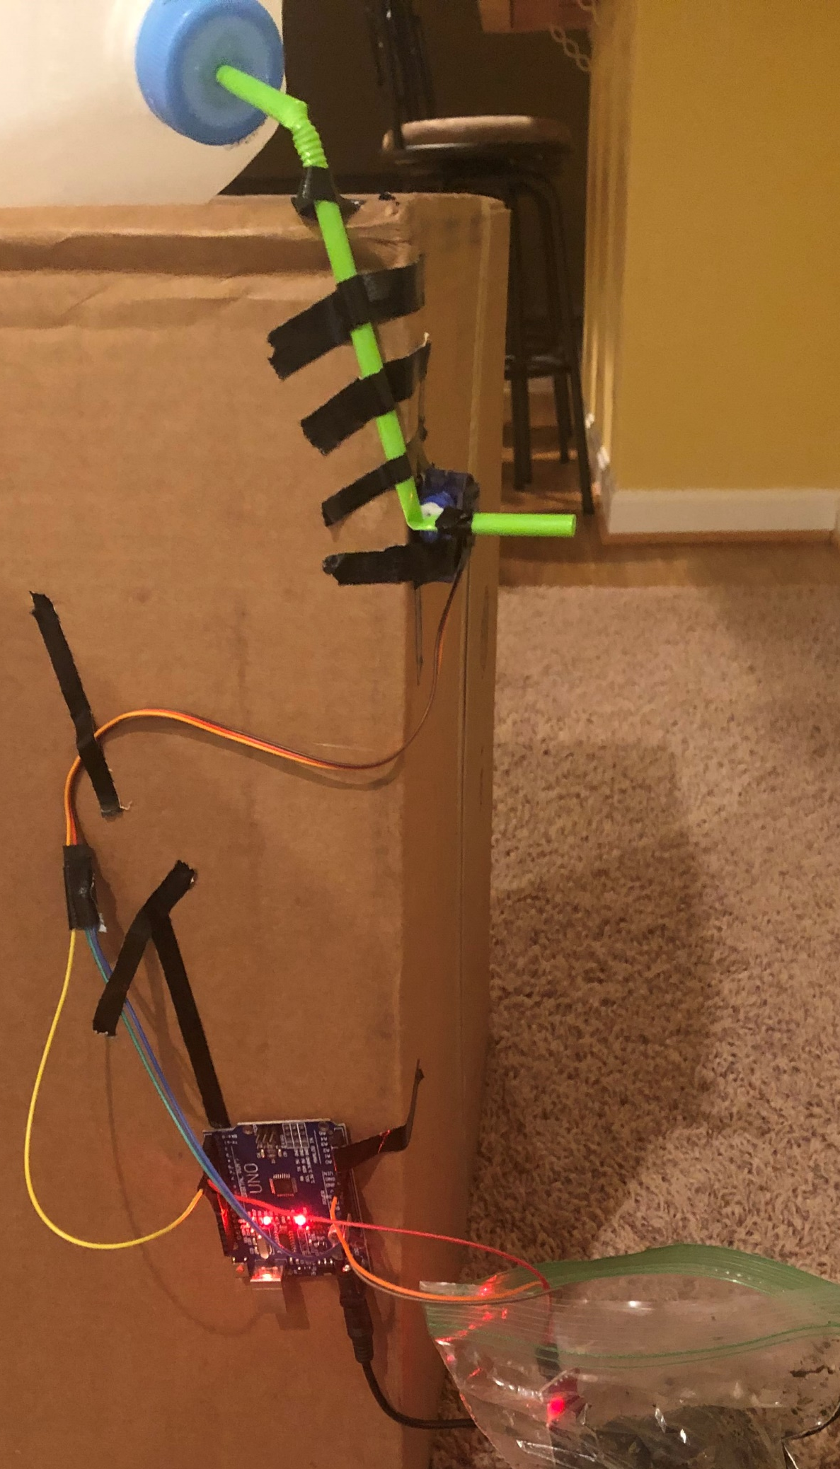
The goal of my project was to make an automatic watering system that could grow a plant. The system continuously measures the water level of the soil and starts watering it if the level is too low. Once it has reached an acceptable level, it stops watering and waits again.

Slide 3
Materials
Arduino board
Breadboard wires
Milk carton/device to hold liquid
Plastic straw or tubing (tube was too hard to crimp)
Water Sensor
Power supply
Box
Tape
Servo (motor)

Slide 4
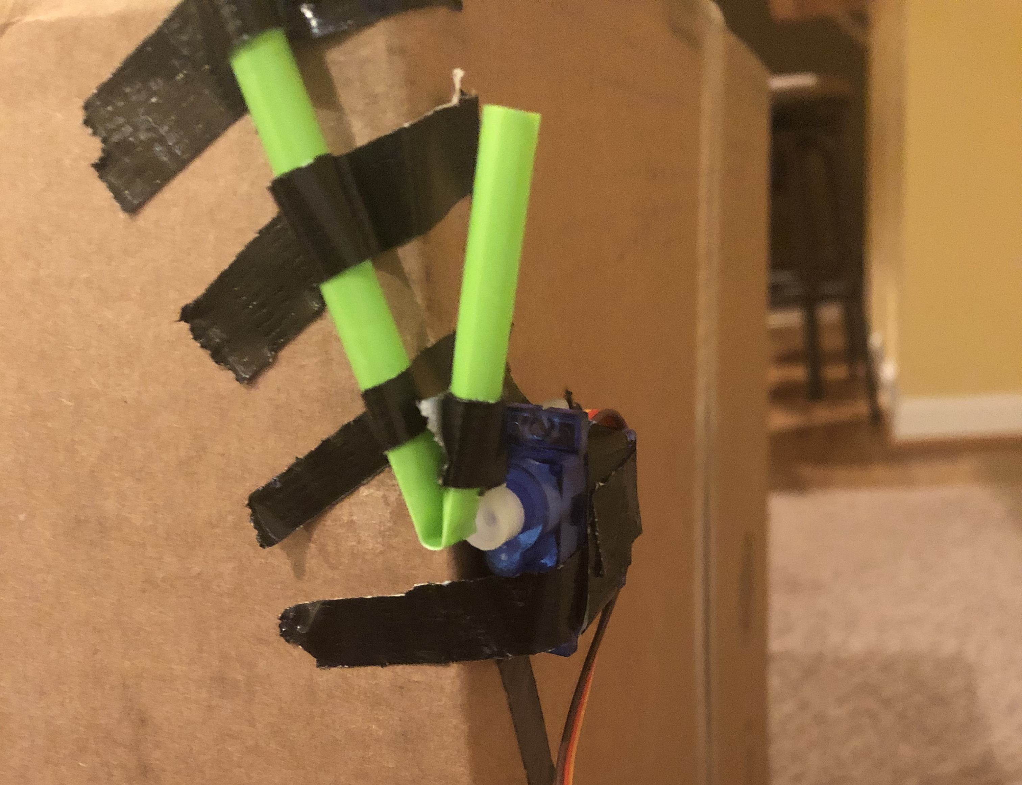
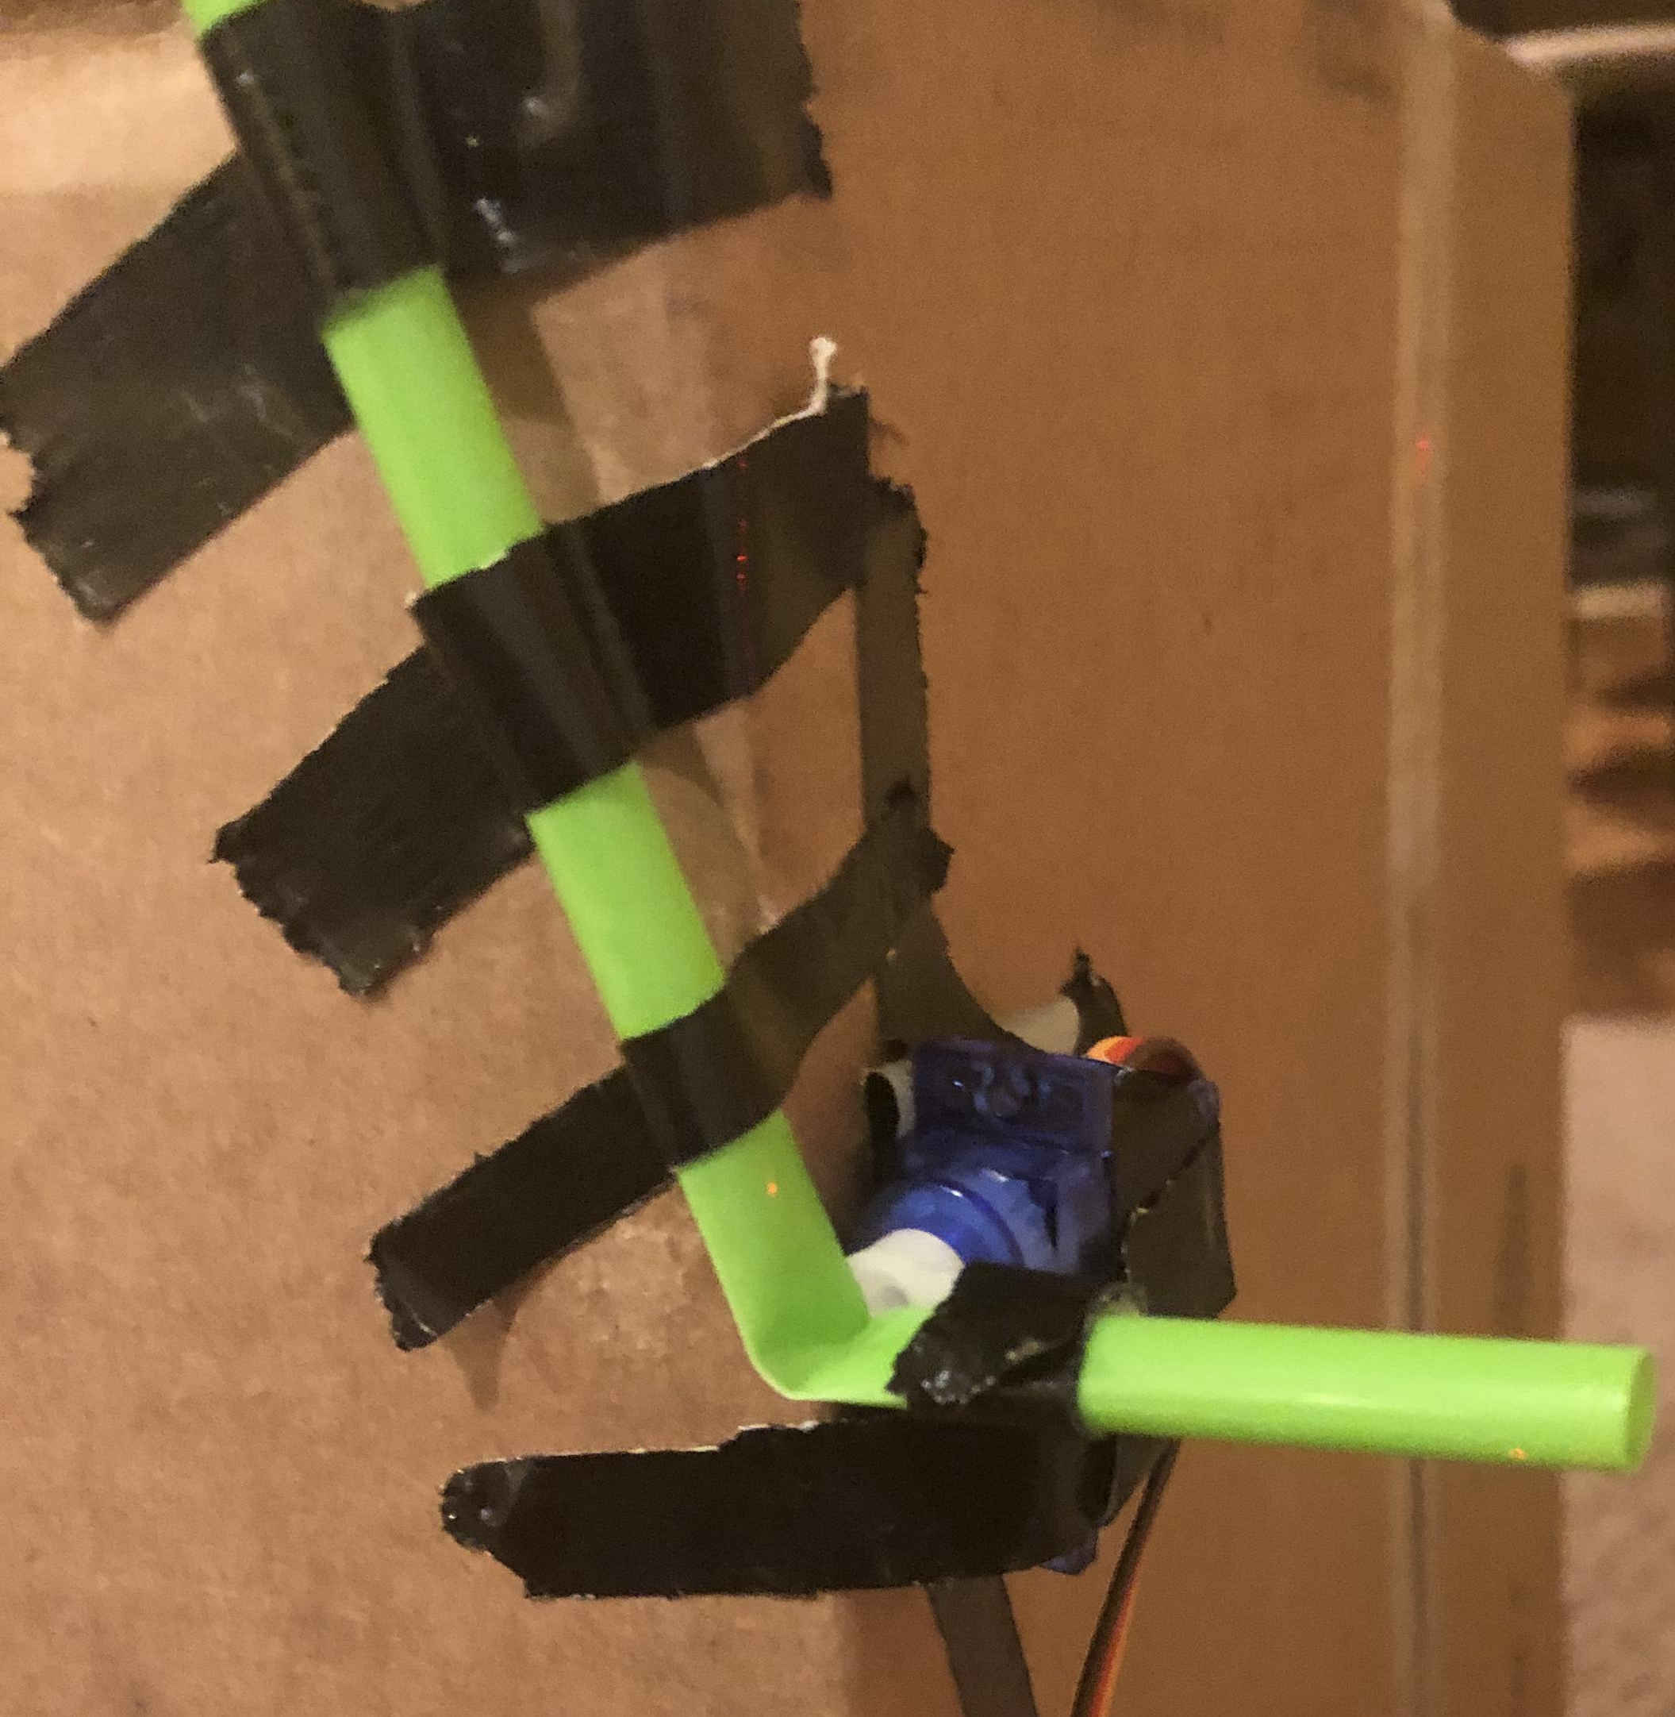
Water release system

Slide 5
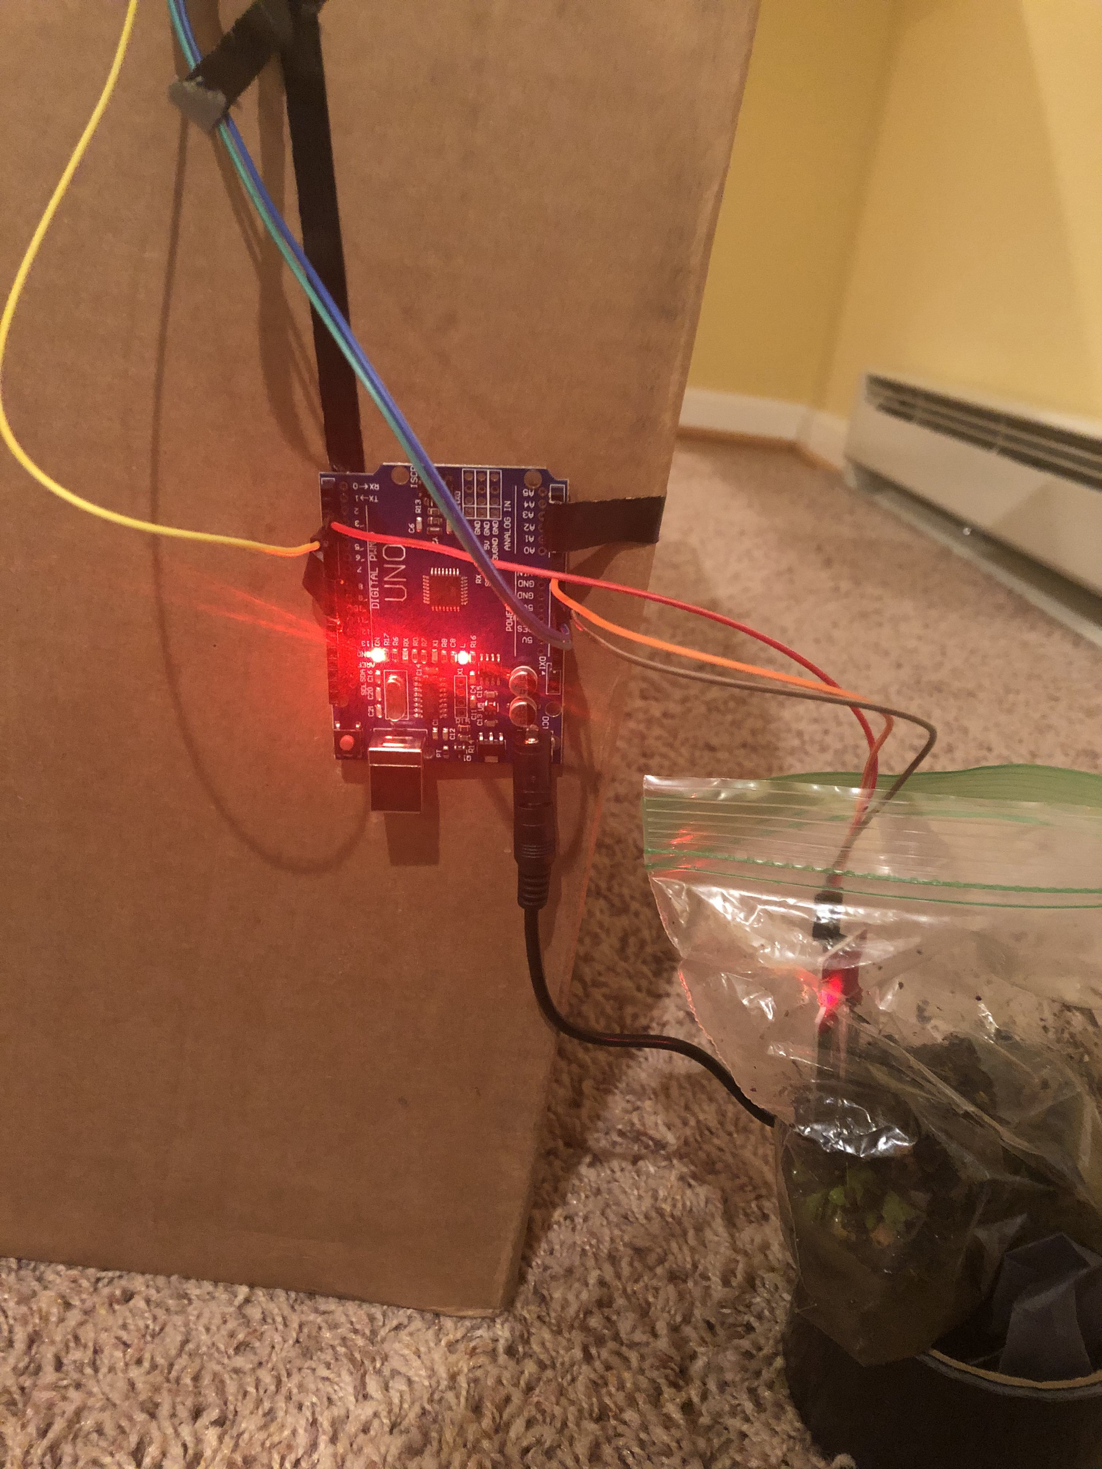
Water Level Sensor

Slide 6
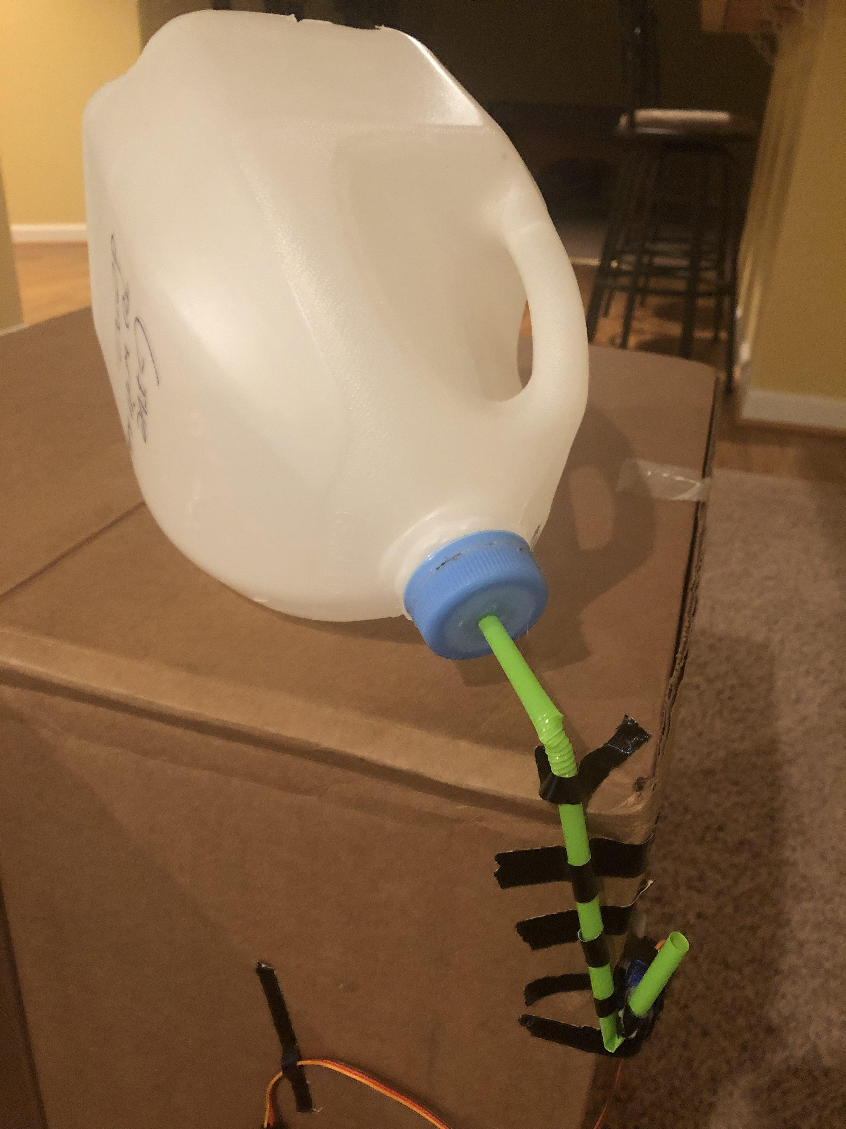
Water container

Slide 7
Video
https://youtu.be/G3Vg0-GVOy4

Slide 8
How the code works
The servo – the motor – is set to a starting position that crimps the straw preventing water flow.
The sensor takes 10 readings for the next 10 seconds
If the average value is below the “Dry Soil” value the motor uncrimps the straw allowing water to flow
This makes the sensor readings rise
After the sensor reads the soil is at the “Sufficiently Wet” value the motor crimps the straw again and the process repeats

Slide 9
Reflection
Unfortunately I was unable to achieve my goal of growing a plant using this device because the technology. Determining the proper wet and dry levels was difficult and required a lot of trial testing and adjustments. I also had a trouble getting the water system to work correctly. I originally used a straw to dispense but couldn’t get the motor to bend the straw properly so I switched to a tube/cord but this was even more difficult so I switched back to a straw using a different design and it worked.

Slide 10
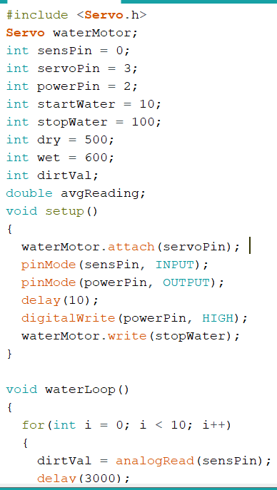
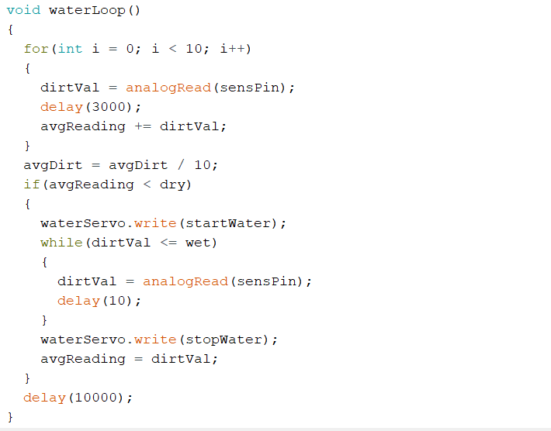
v

